Slide 1
Success Pattern Discovery & Strategic Insights
Presented by Tri Umiati

Slide 2
Project Objective
Identify what drives Rating 5 (R5) performance
Benchmark other employees against these success patterns
Support data-driven talent decisions

Slide 3
Analysis Framework
Four Dimensions Analyzed:
Competency
Psychometric
Behavioral
Contextual Factors
Each tested independently, then integrated into a unified success formula.

Slide 4
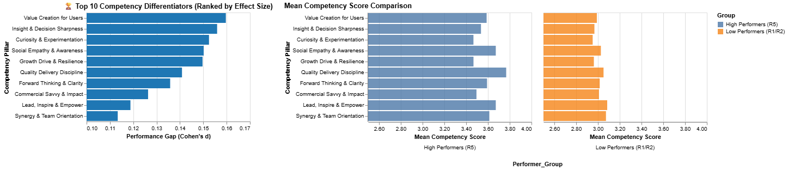
Competency Analysis
Compared R5 vs R1/R2 scores
Largest gaps in:
Value Creation for Users
Insight & Decision Sharpness
These define execution excellence

Slide 5
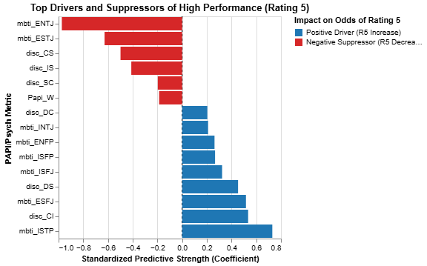
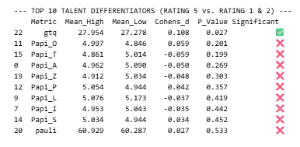
Psychometric Analysis
Cognitive Power (GTQ) is the strongest predictor of high performance.
MBTI: ISTP and DISC: CI profiles consistently appear in top performers.
Traits like ENTJ and ESTJ are less likely to achieve Rating 5.
Common traits like agreeableness or extraversion show no independent impact.

Slide 6
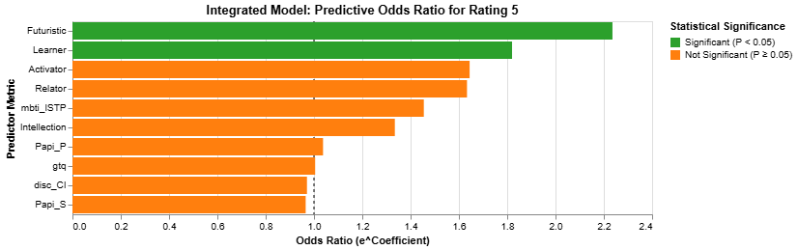
Behavioral Analysis
Controlled for all other variables
Only Futuristic and Learner themes remained significant
These traits independently accelerate performance

Slide 7
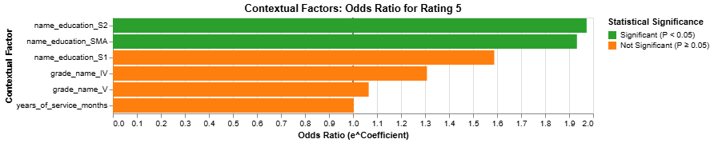
Contextual Factor Analysis
Tested tenure, grade, and education
Only Education Level (S2, SMA) showed predictive value
Tenure and grade were statistically irrelevant

Slide 8
Final Success Formula
Rating 5 Potential = 75% Behavioral Mindset + 15% Execution Competency + 10% Structural Filter
Justification for Weights
Behavioral Mindset (75%): Futuristic and Learner traits were the only statistically significant, non-redundant drivers of high performance.
Execution Competency (15%): Value Creation and Decision Sharpness showed the largest performance gaps between R5 and others.
Structural Filter (10%): Only Education Level (S2, SMA) had predictive power; Tenure and Grade were irrelevant.

Slide 9
Strategic Takeaways
Mindset is non-negotiable
Futuristic and Learner traits must be prioritized in hiring, development, and succession planning.
Execution converts mindset into impact
Top performers deliver value through sharp decisions and user-focused outcomes.
Tenure and grade are outdated filters
Only education level showed predictive value. Focus on high-potential talent pools.
Psychometric traits offer behavioral signals
ISTP and CI profiles outperform traditional dominant types like ENTJ and ESTJ.
Use the formula to benchmark and develop talent
Apply it to identify hidden potential, guide promotions, and build high-performing teams.

